Slide 1
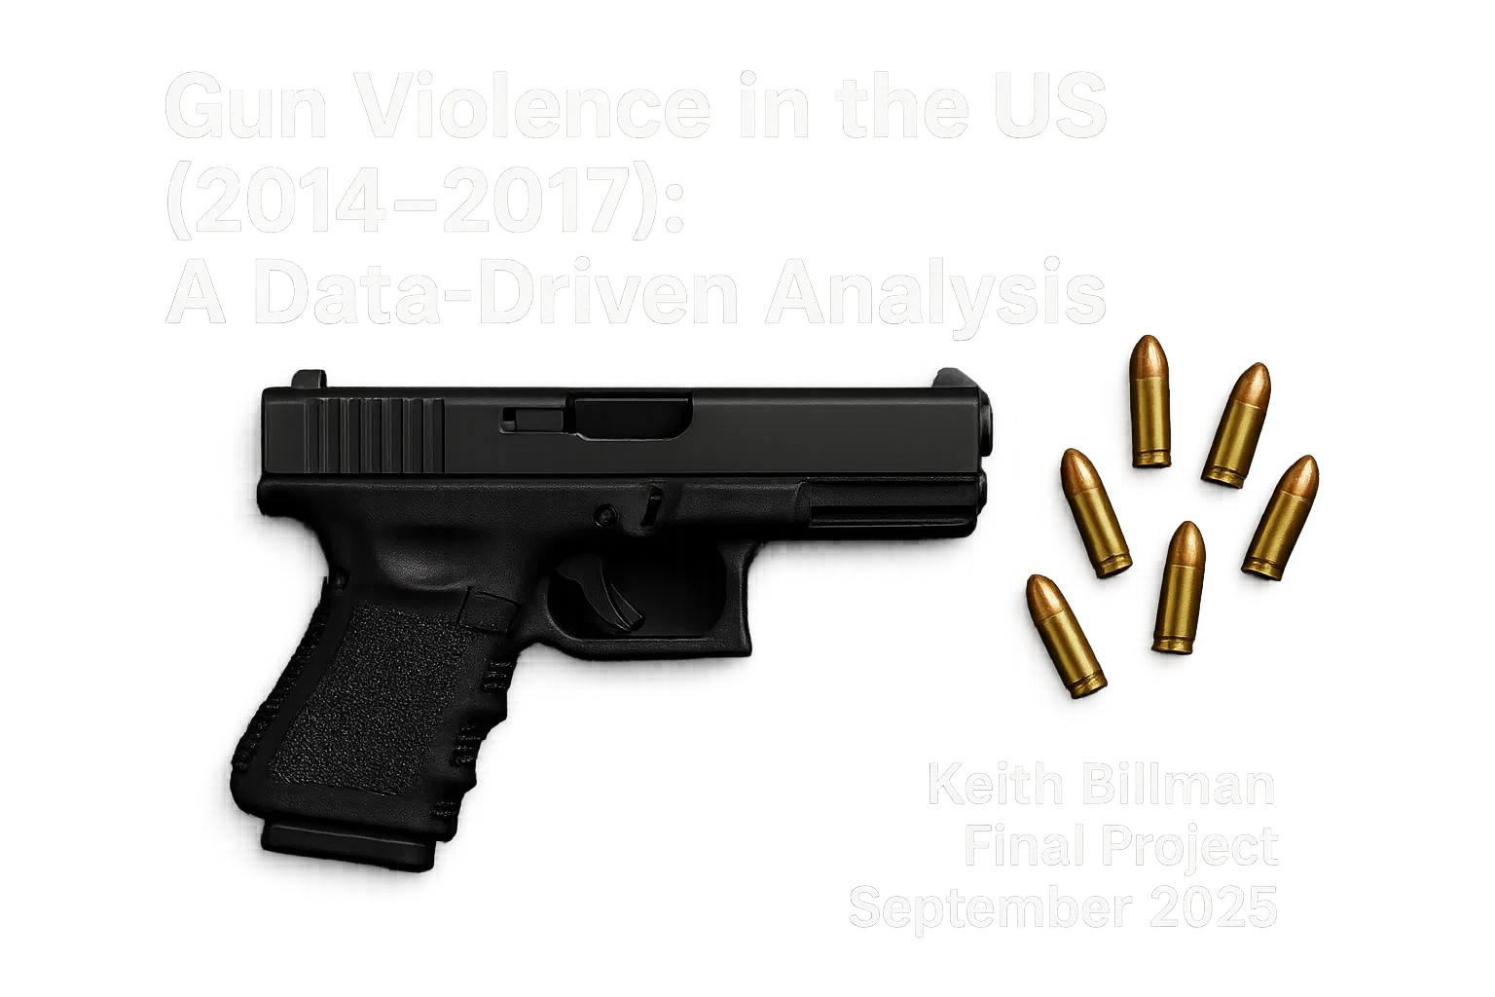

Slide 2
Contents
Introduction and Dataset Overview
Data Cleaning and Engineering
Exploratory Data Analysis
Comparative Data Analysis
Clustering
Predictive Modeling
Conclusions and Limitations

Slide 3

Intro: What Are We Exploring?
What are the trends in U.S. gun violence incidents?
How fatal are these incidents, and what factors influence them?
Are there patterns of time and place?
Can we identify meaningful clusters or predictive signals?

Slide 4
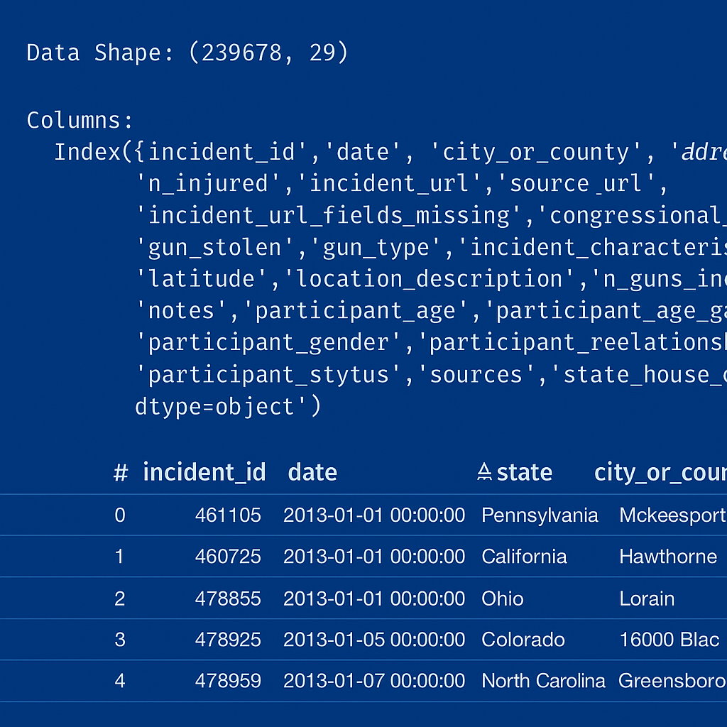
Dataset Overview
Source: Gun Violence Data Hub
gun-violence-data.csv
239,678 incidents across the U.S. between 2013-2018
29 columns including:
date
state and city/county
no# killed and/or injured
gun type, number of guns
participant information

Slide 5

Dropped irrelevant columns (e.g., latitude, longitude)
Dropped columns with high missing values (participant name, age, relationship to shooter)
Check for duplicates
Created new features: Total victims, month, year, weekday,
Mass shooting flag (>=4 shot or killed excluding the shooter)
Manually added missing Las Vegas shooting data (2017)
Dropped incomplete 2013 and 2018 data

Slide 6
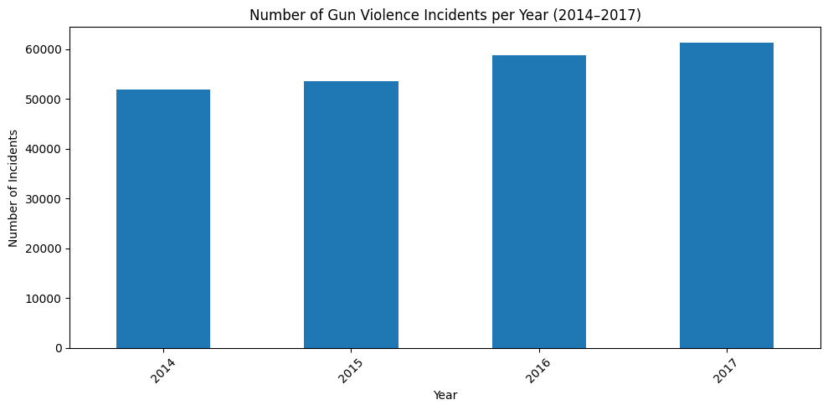
Incidents by Year

Slide 7
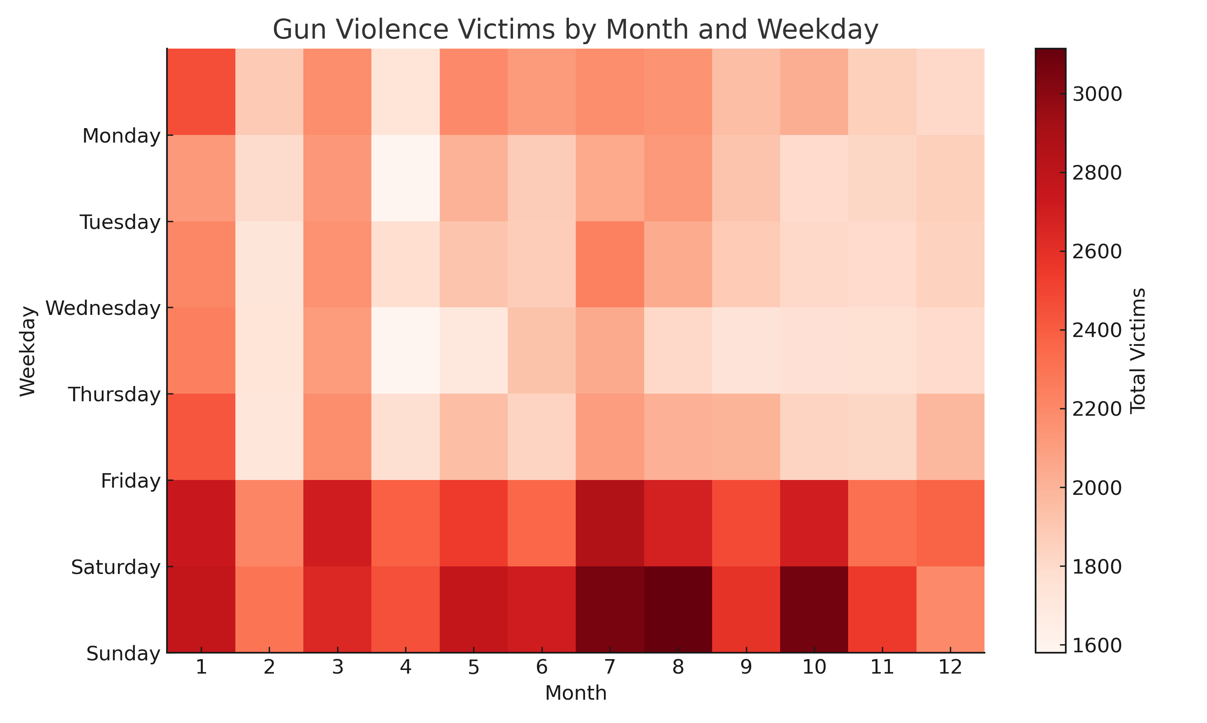
Combined Monthly and Weekly Patterns

Slide 8
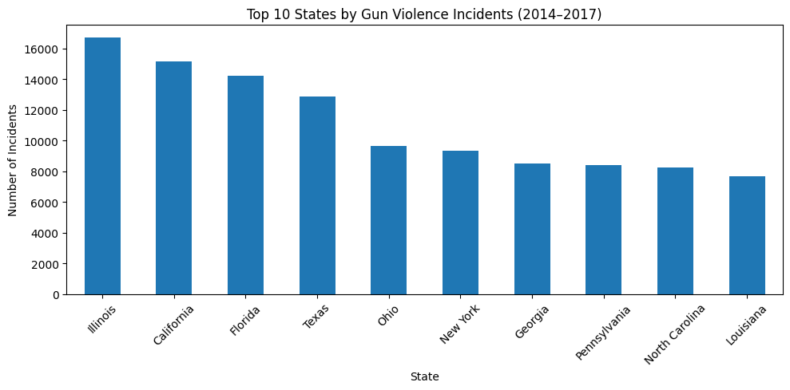
State-Level Totals

Slide 9
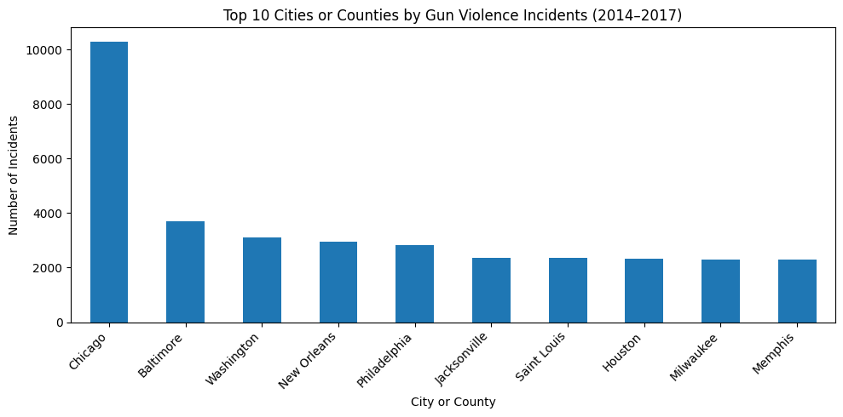
Top 10 Cities

Slide 10
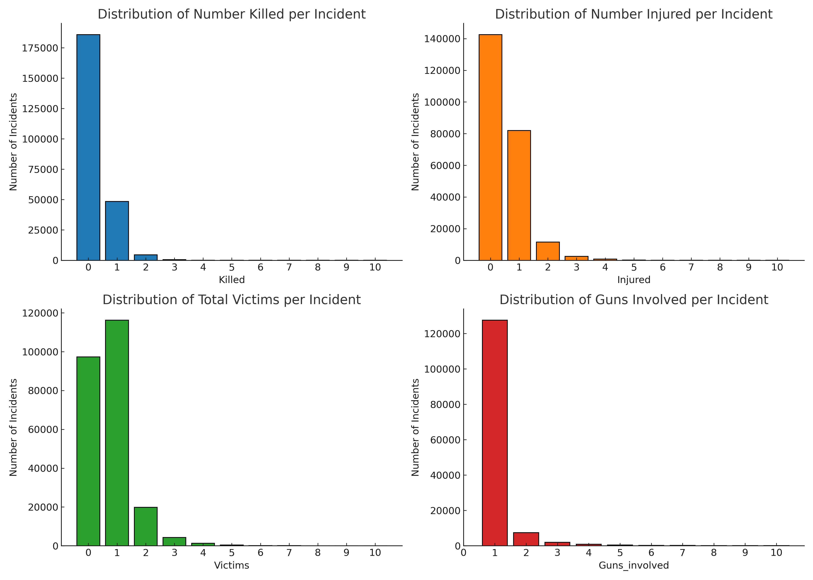
Distributions

Slide 11
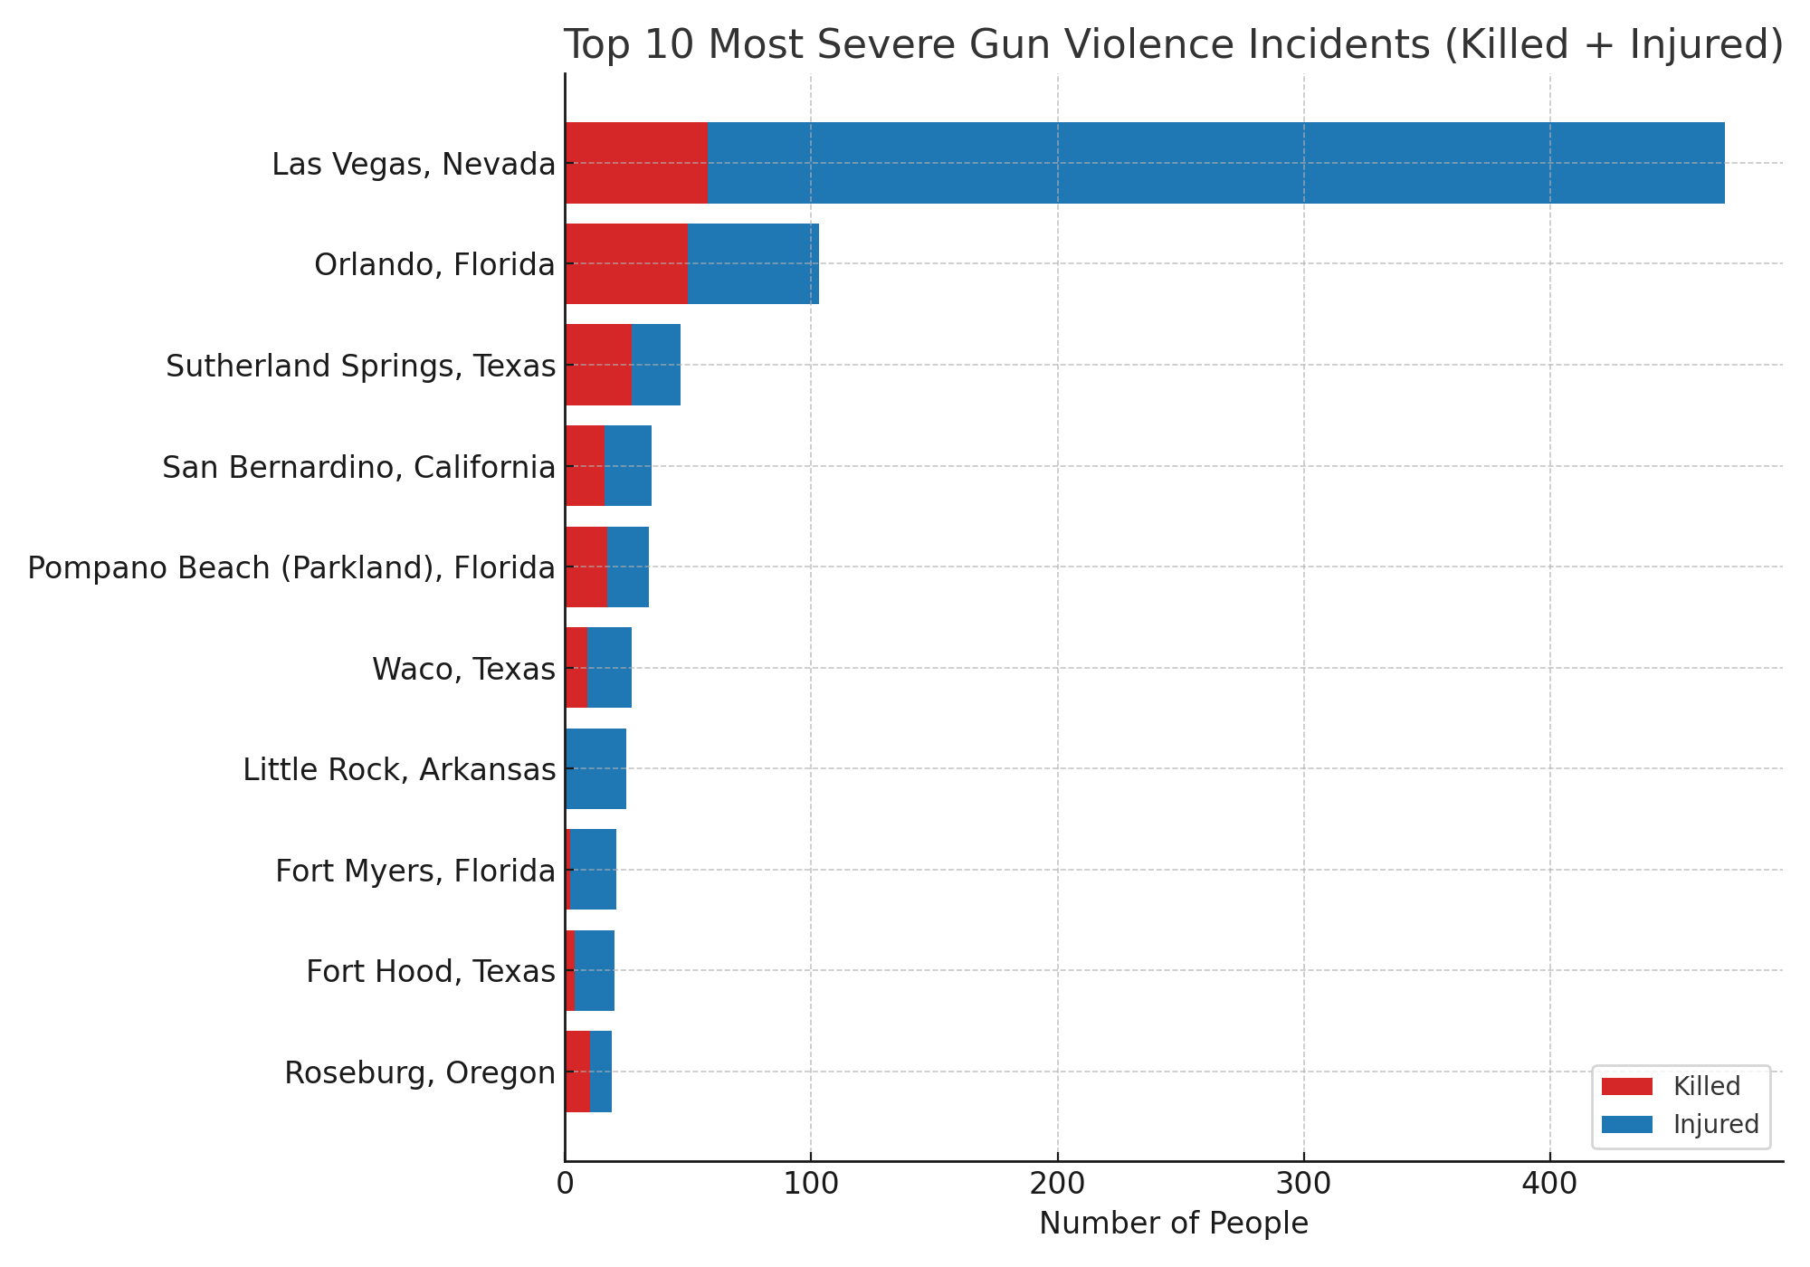
Most Severe Incidents
View Interactive Chart

Slide 12
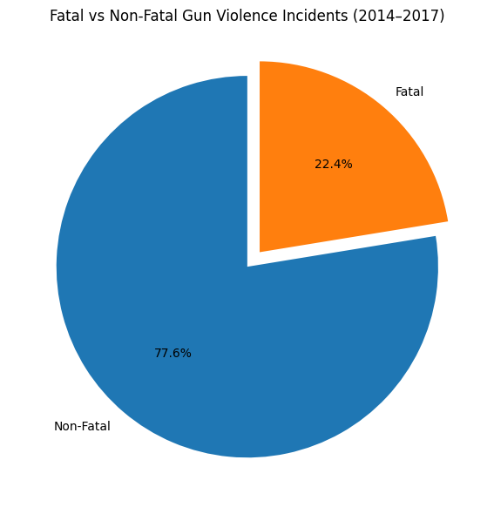
Fatal vs. Non-Fatal Incidents

Slide 13
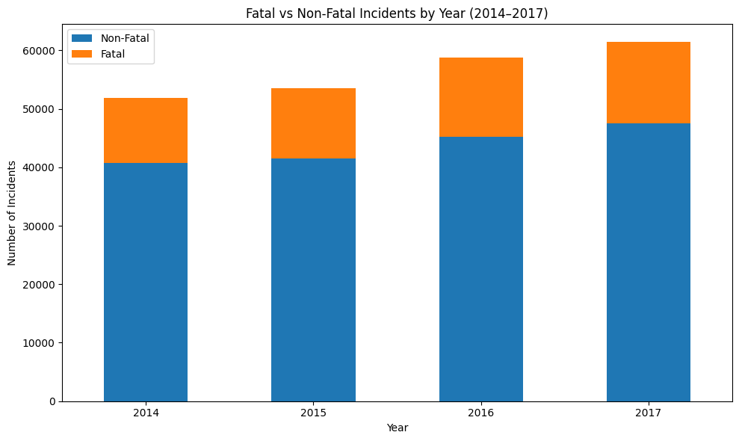
Fatal vs. Non-Fatal Incidents by Year

Slide 14
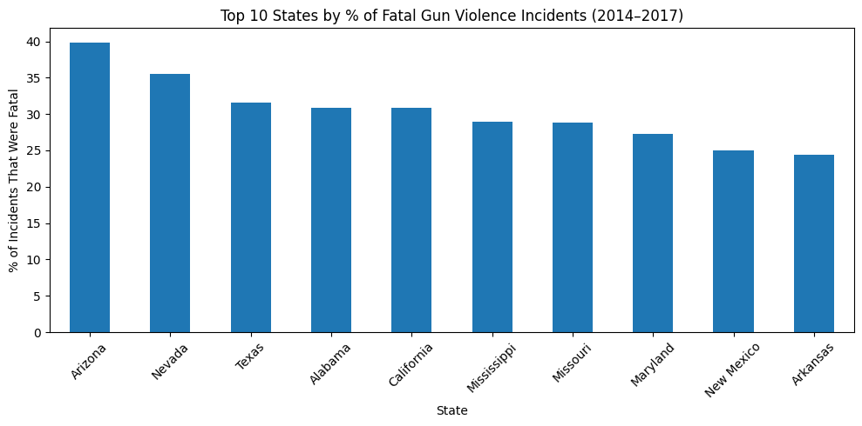
Top 10 States by % of Fatal Incidents

Slide 15
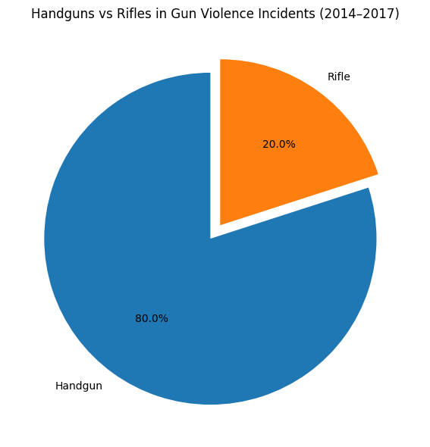
Weapons Used

Slide 16
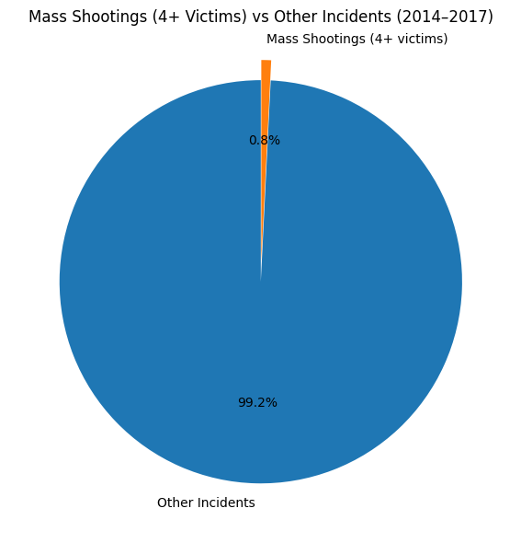
Mass Shootings

Slide 17
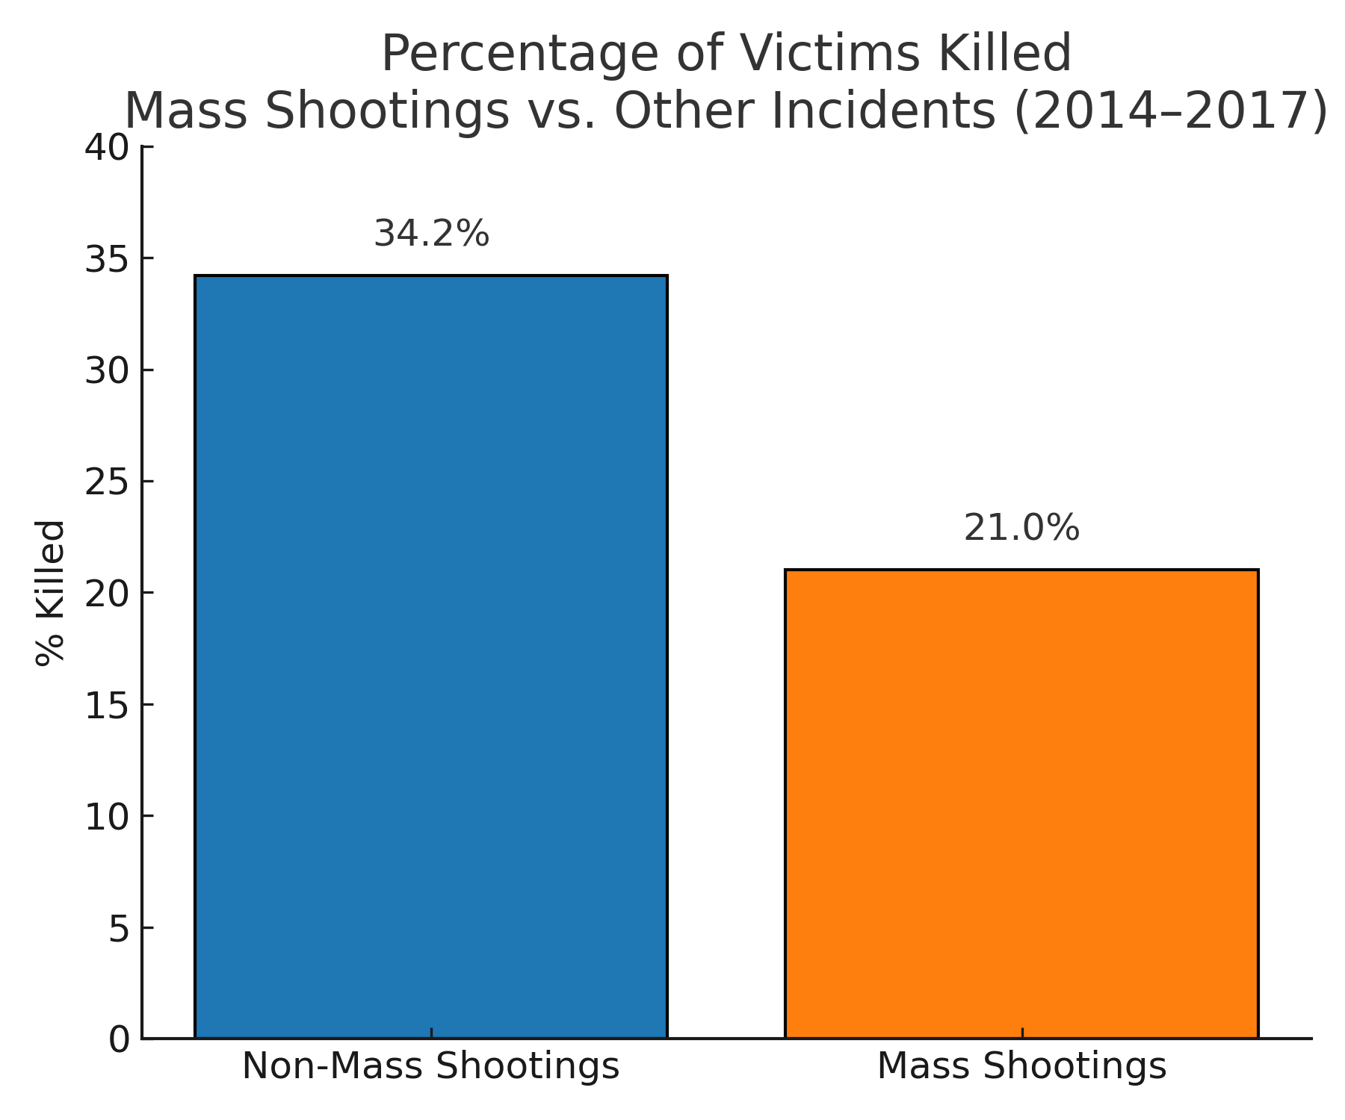
% of Victims Killed

Slide 18
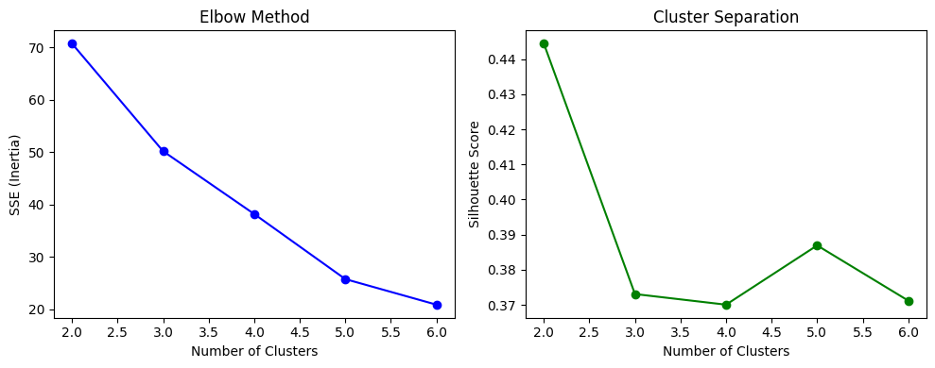
Clustering

Slide 19
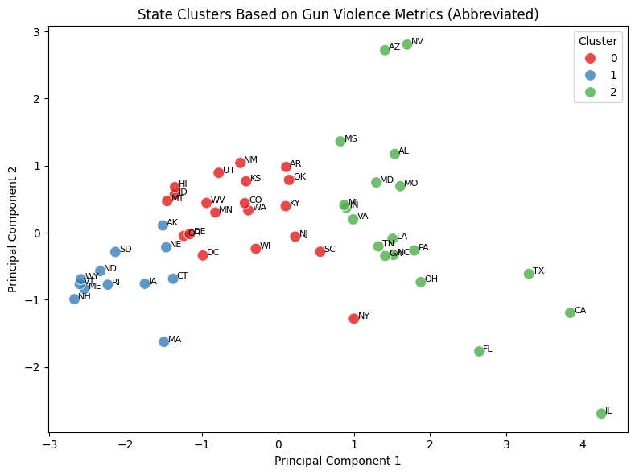
Cluster Visualization - PCA

Slide 20
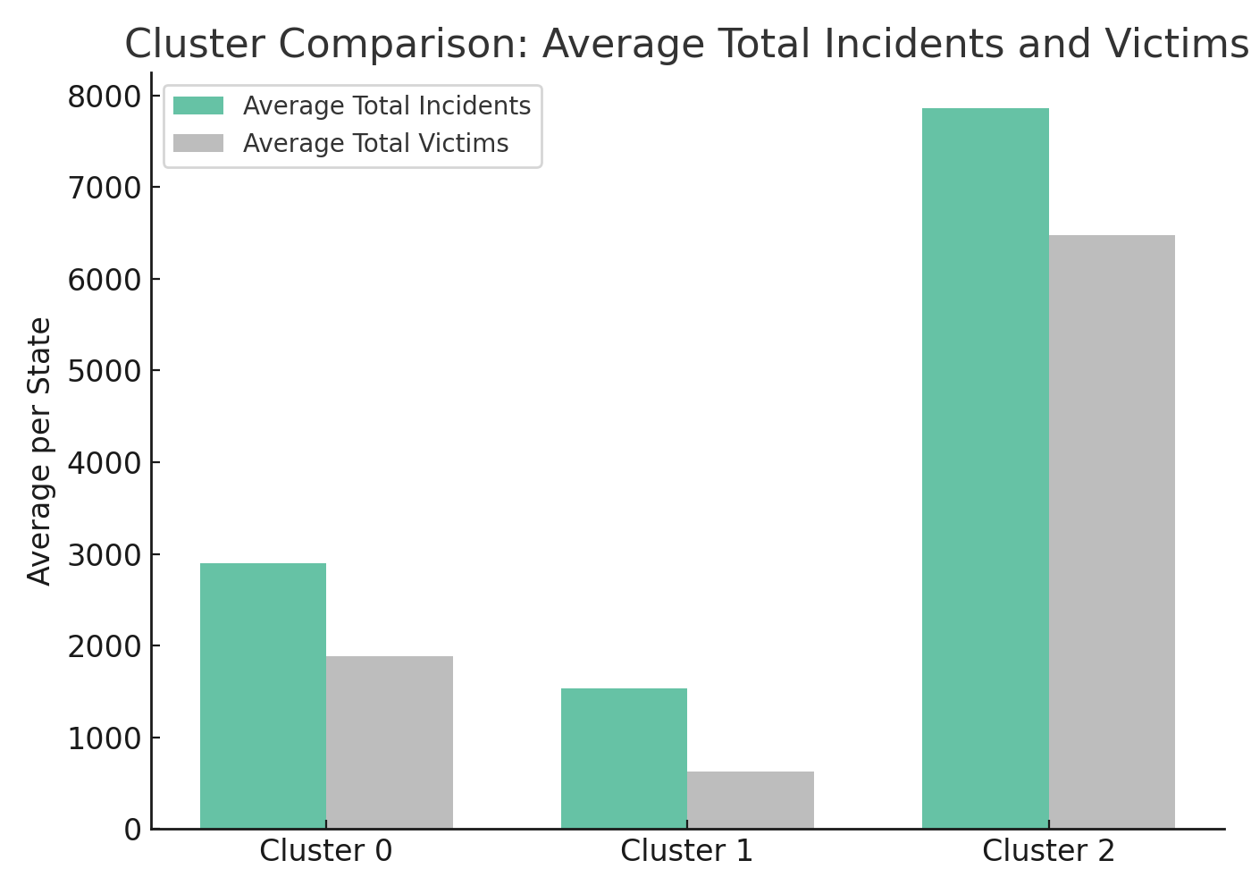
Cluster Comparison : Avg. Incidents and Victims

Slide 21
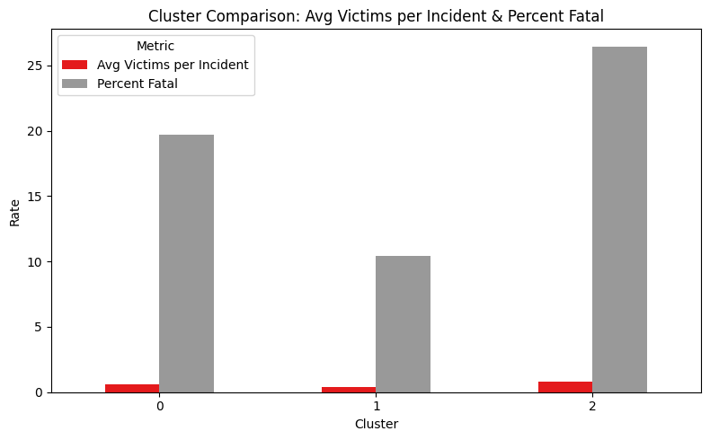
Cluster Comparison: Avg. Victims/Incident and % Fatal

Slide 22
Cluster Profiles
Cluster | Label | Avg. Incidents | Avg. Victims | Avg. Victims /Incident | % Fatal | Definition
0 | High-Incidence, Moderate-Fatality | 2,894 | 1,887 | 0.62 | 20% | High frequency and number of victims; moderate fatality rate.
1 | Low-Incidence, Low-Fatality | 1,529 | 624 | 0.38 | 10% | Safest states; fewer incidents and lowest fatality per incident.
2 | Very High-Incidence, High-Fatality | 7,862 | 6,480 | 0.84 | 26% | Most violent states overall; frequent and deadly events with the most victims and highest fatality rate.

Slide 23
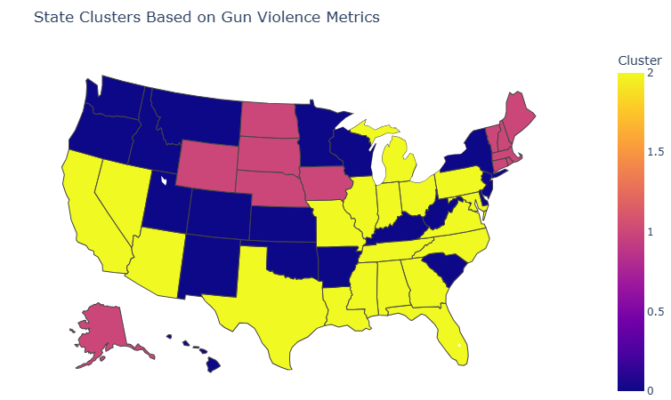
Gun Violence across the US
View Interactive Version

Slide 24
Predictive Modeling
Goal: Predict whether an incident is fatal
Tested Logistic Regression:
underperformed significantly
(AUC ~0.58)
Random Forest Features:
no# victims
gun type
state

Slide 25
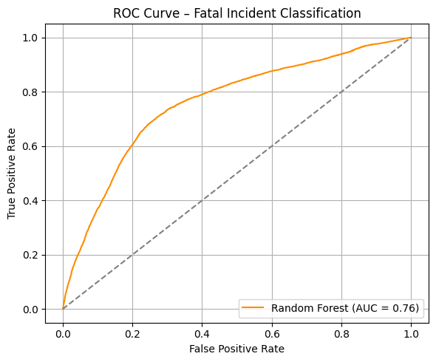
ROC Curve -
Random Forest

Slide 26
Model Evaluation
Class | Precision | Recall | F1 Score | Support
Non-Fatal | 0.90 | 0.73 | 0.80 | 21,805
Fatal | 0.43 | 0.71 | 0.53 | 6,241
Accuracy | — | — | 0.72 | 28,046
Macro Avg | 0.66 | 0.72 | 0.67 | 28,046
Weighted Avg | 0.79 | 0.72 | 0.74 | 28,046

Slide 27
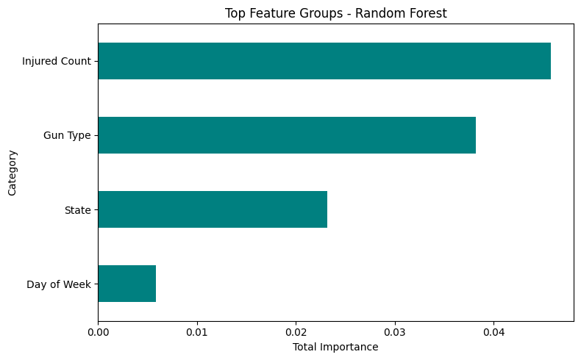
Feature Importance

Slide 28

Conclusions
Gun violence increased every year from 2014-2017
Most populous states have most violence but not necessarily the highest % of fatalities
Chicago is the most violent city, Las Vegas 2017 worst incident
Higher levels of violence on weekends and in summer
Most incidents involve 0-1 victim (1 injury or fatality) and 1 gun
State-level clustering revealed patterns
Prediction (fatal vs. non-fatal) possible but not highly precise

Slide 29
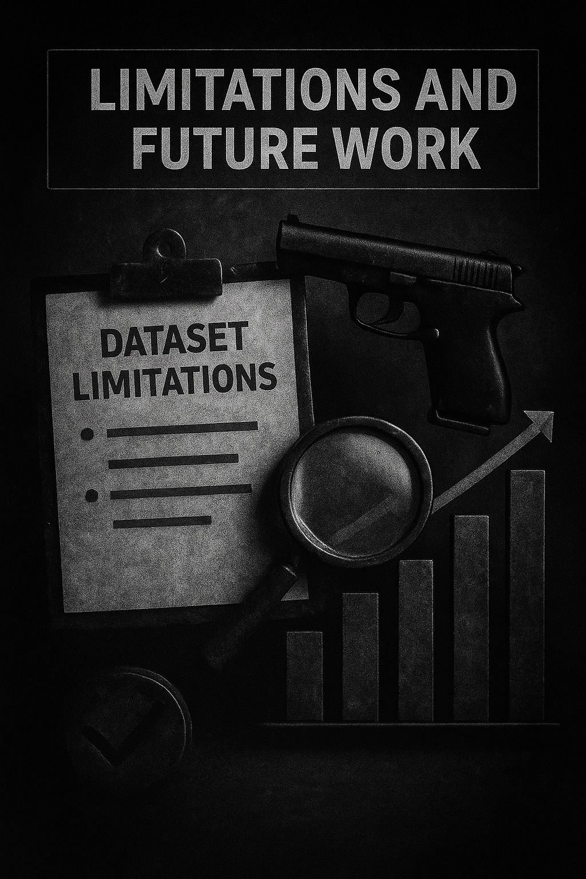
Limitations:
No demographics, income, or law/policy variables
No time to research legislative districts
Gun origin data (stolen, legal) often missing
Type of violence (e.g. domestic, gang-related) incomplete
Type of location (school, nightclub, etc.) missing
Future work:
Merge with other datasets (e.g. census data)
Expand with newer data (Full year 2018 – present)

Slide 30

Action Items
Gun Laws and Policies
Universal Background Checks (licensed dealers vs. private sellers)
Extreme Risk Protection Orders (danger to others or self – mental health, suicidal)
Regulation of Public Carry (stricter laws)
Disarm Felons and Domestic Abusers (strengthen federal law)
Community-Based Solutions
Community Violence Intervention (programs supported and funded)
Mental Health Support (services and resources)
Community Engagement (Planning and implementation of prevention efforts)
Systemic and Research Approaches
Fund Research (understand causes and develop solutions)
Address Social Determinants (e.g. poverty, lack of opportunity)
Data Collection and Sharing (assess effectiveness of strategies)

Slide 31

Questions?
Thank you!
Any Questions?

